Slide 1
Phishing Awareness
By Khalid Diriye

Slide 2

Phishing: Process of attempting to steal private information such as credit card numbers, usernames, and passwords via email, phone, or social media.

Slide 3
How it’s done:
Phishing messages try to make themselves look like a trustworthy person or organization by copying format styles such headers, or even signatures.
User afterwards clicks on a link provided in the message and are attacked after being directed to the page the attacker wants them to go to.

Slide 4
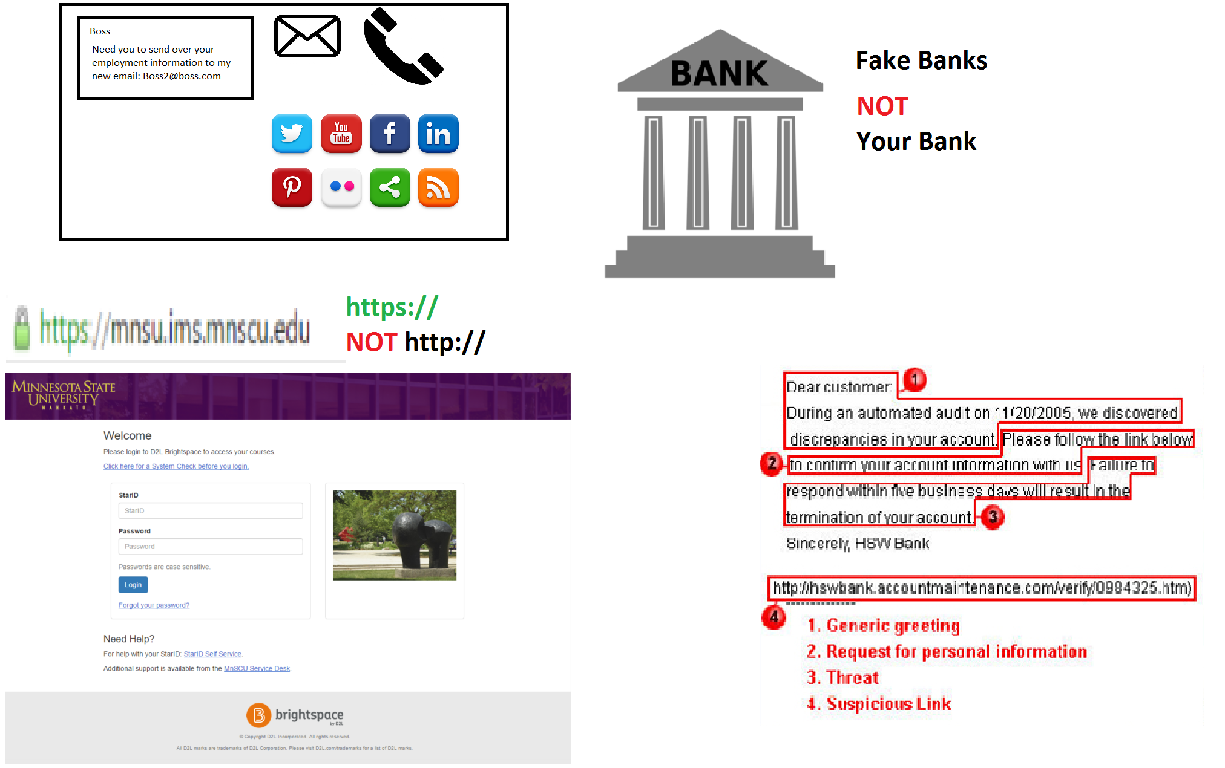

Slide 5
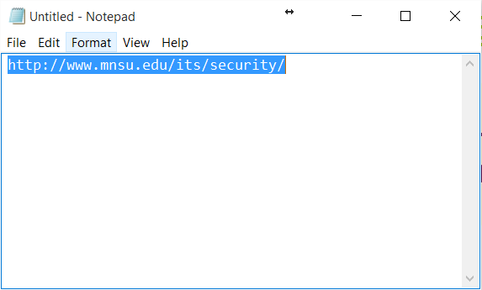
Check for Phishing messages
How to do check links?
CLICK HERE!!! <- Example
Right Click – Copy – Paste into Notepad and verify the link is valid.

Slide 6
Report Spam & Phishing
spam@mnsu.edu – If you receive or have received a phishing email.
If you have ever received phishing or scam emails, please delete them from your inbox.
Run an antivirus/anti malware scan. For assistance running a scan, visit http://www.mnsu.edu/its/security/antivirus.html

Slide 7
Reminder
ITS at Minnesota State University, Mankato will never ask you to provide personal or confidential information in an email.

Slide 8
More Information
Information Security Blog Posts: http://www.mnsu.edu/its/security/blog/
Cyber Security Posts: http://www.mnsu.edu/its/security/cybersecurity.html

